Slide 1

DEPARTMENT OF COMPUTER ENGINEERING, MODELING, ELECTRONICS AND SYSTEM ENGINEERING
LM-Telecommunication Engineering: Smart Sensing, Computing and Networking
Distributed Systems and Cloud/Edge Computing
Project Title: Sustainably Smart Facility
Implemented by:
Rami Saleh Hussein Mohammed

Slide 2
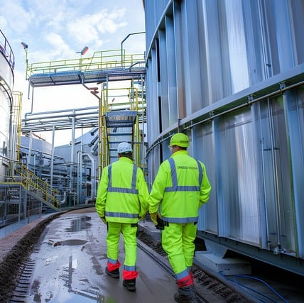
Introduction
Overview of the project:
An IoT-based system for environmental monitoring and control.
Focuses on real-time data collection, analysis, and automation.
Purpose: Ensure sustainable operations and proactive environmental management.

Slide 3
Hardware Components
ESP32 Microcontroller.
DHT11 (Temperature & Humidity Sensor).
MQ2 Gas Sensor.
Actuators: Fan and Servo Motor.

Slide 4
AWS Services
AWS IoT Core: Manages communication between ESP32 and the cloud.
AWS Lambda: Processes sensors data and controls actuators.
Amazon DynamoDB: Stores real-time sensor data.
Amazon S3: Archives sensor data for analysis.
Amazon SNS: Sending notifications and alerts.
Amazon CloudWatch: Monitoring system performance.
Amazon Glue & Athena: Data analysis and reporting.

Slide 5
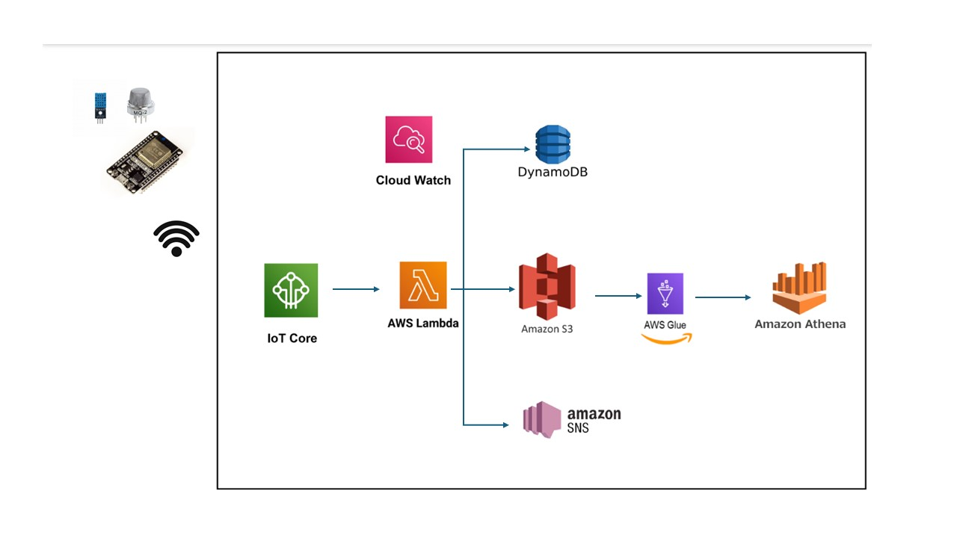
Architecture Diagram

Slide 6
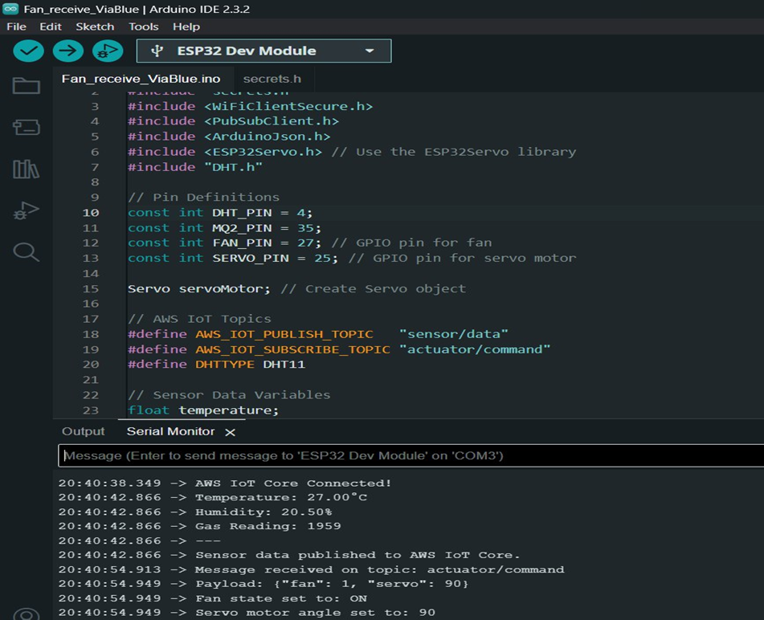
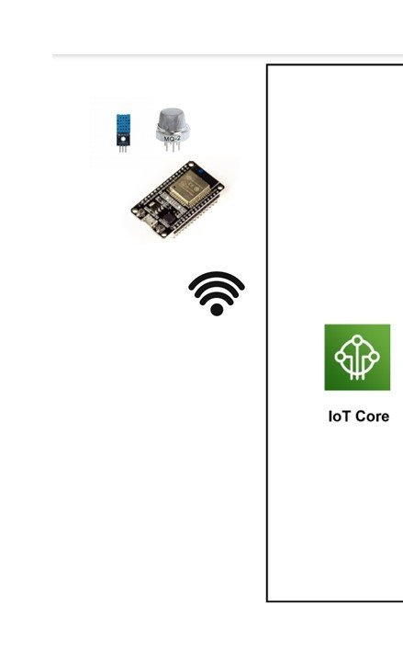
Implementation
ESP32 send the data to MQTT Broker (AWS IOT Core) and receive the actuators command to control it.

Slide 7
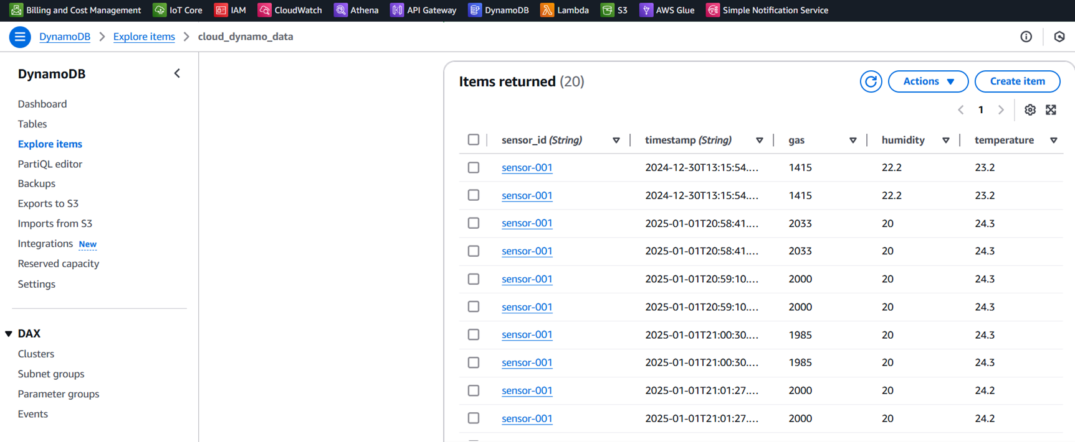
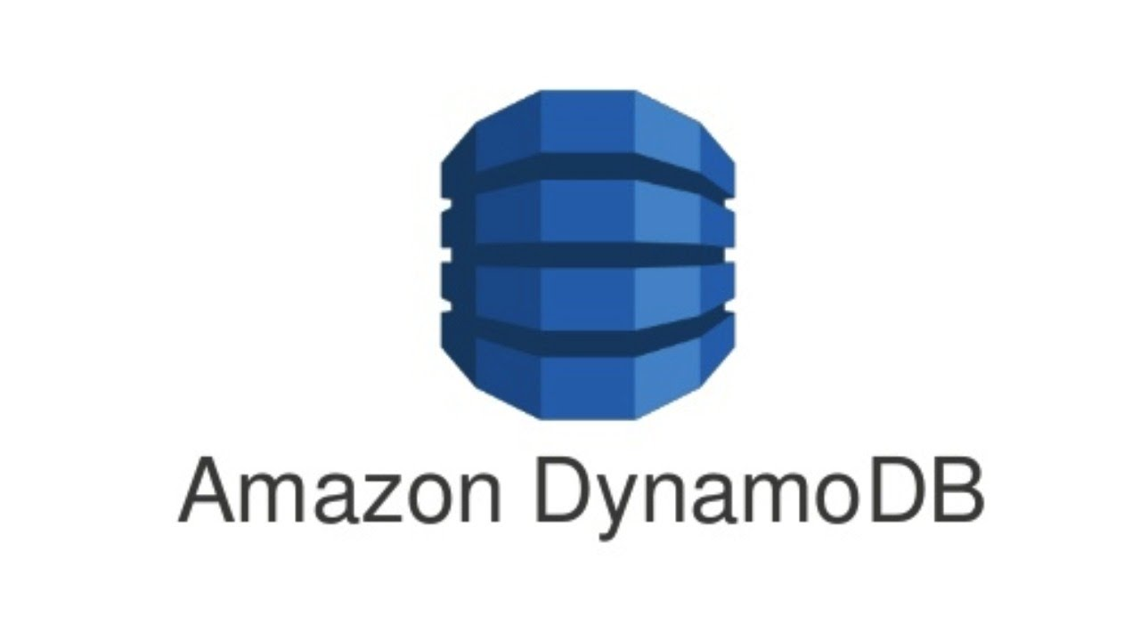

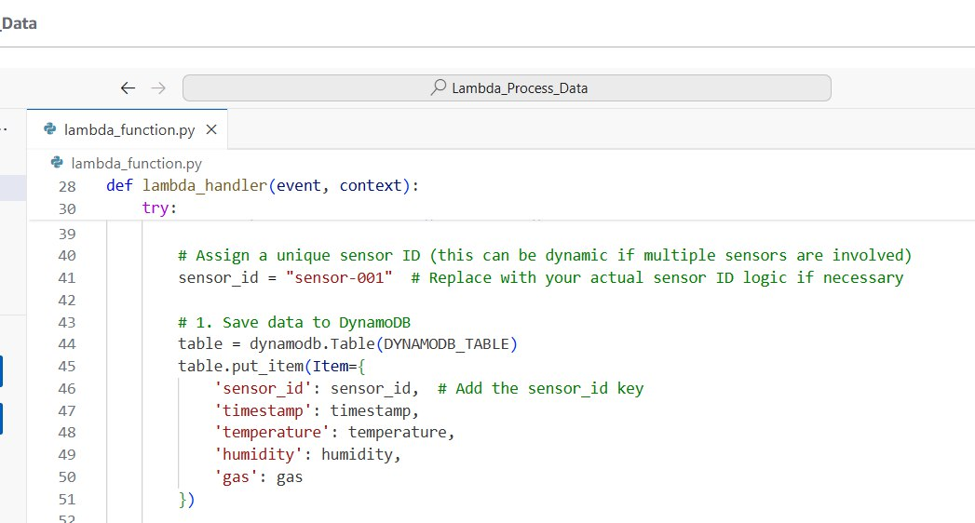
Implementation
Lambda service Send the values to Dynamo DB service which stores structured, real-time sensor data in a NoSQL database

Slide 8

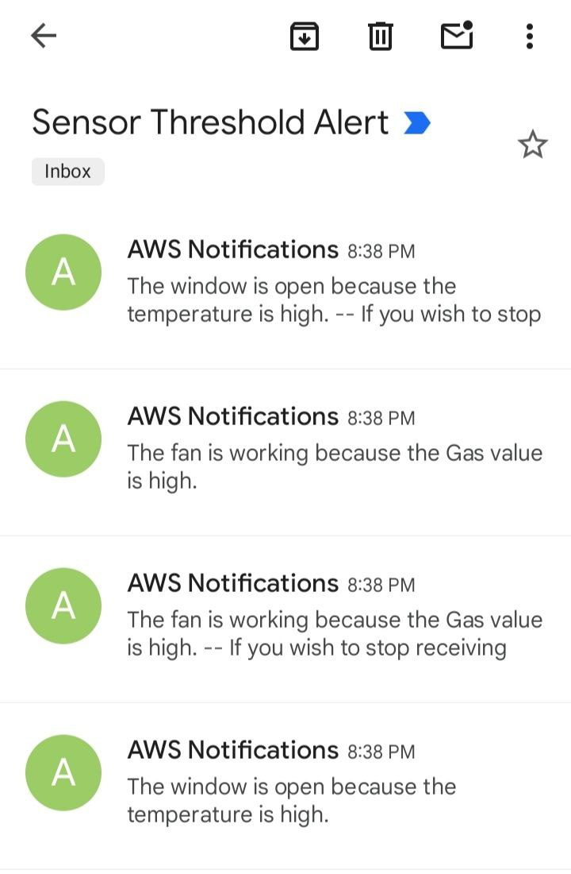
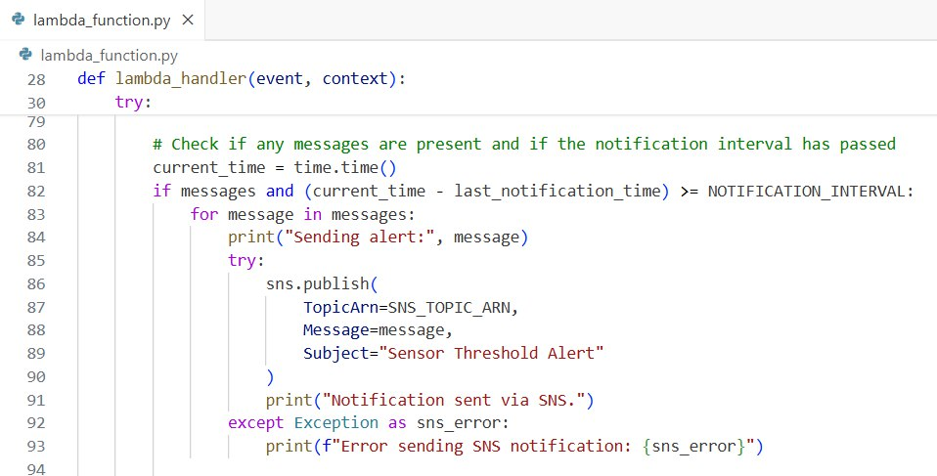
Implementation
Lambda service will send notification by Email through SNS service (which involves the state of the actuators after one or more values exceeded the threshold).

Slide 9
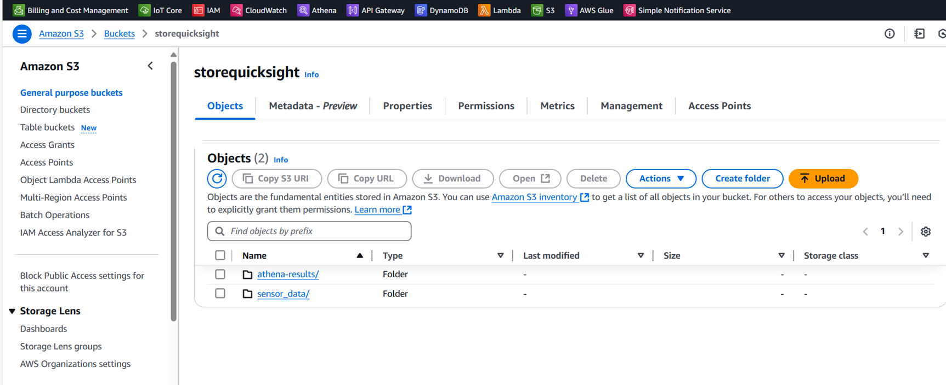

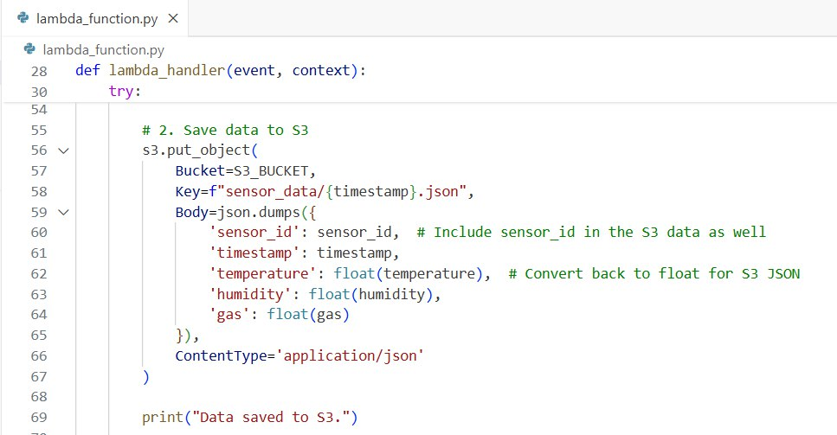
Implementation
Lambda service will Send the values to S3 service archives sensors data as JSON files for long-term storage and advanced analytics
The bucket “storequicksight” contains folders such as: 1- “sensor_data/” for JSON files representing sensors readings. 2- “athena-results/” for query outputs.

Slide 10
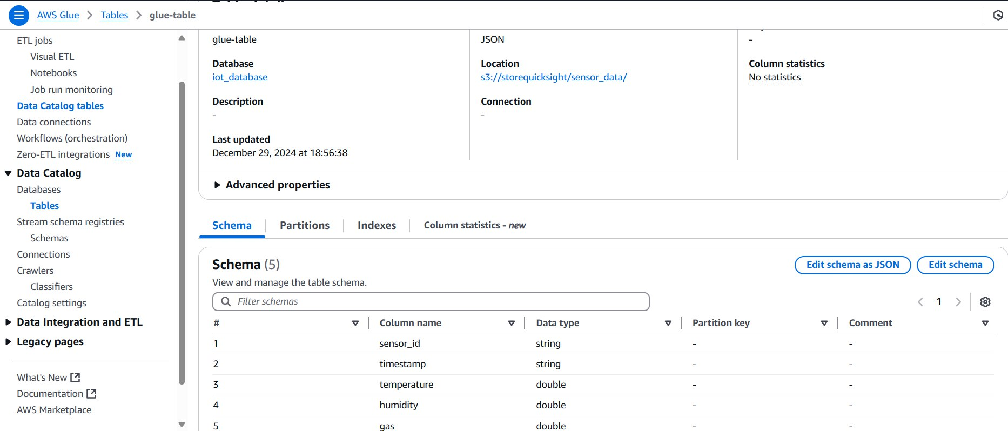

Implementation
AWS Glue integrates with S3 to prepare the data for analysis. Glue Crawler scan the “sensor_data/” folder to detect the schema and create a metadata catalog and this catalog allows Amazon Athena to query the sensor data stored in S3

Slide 11
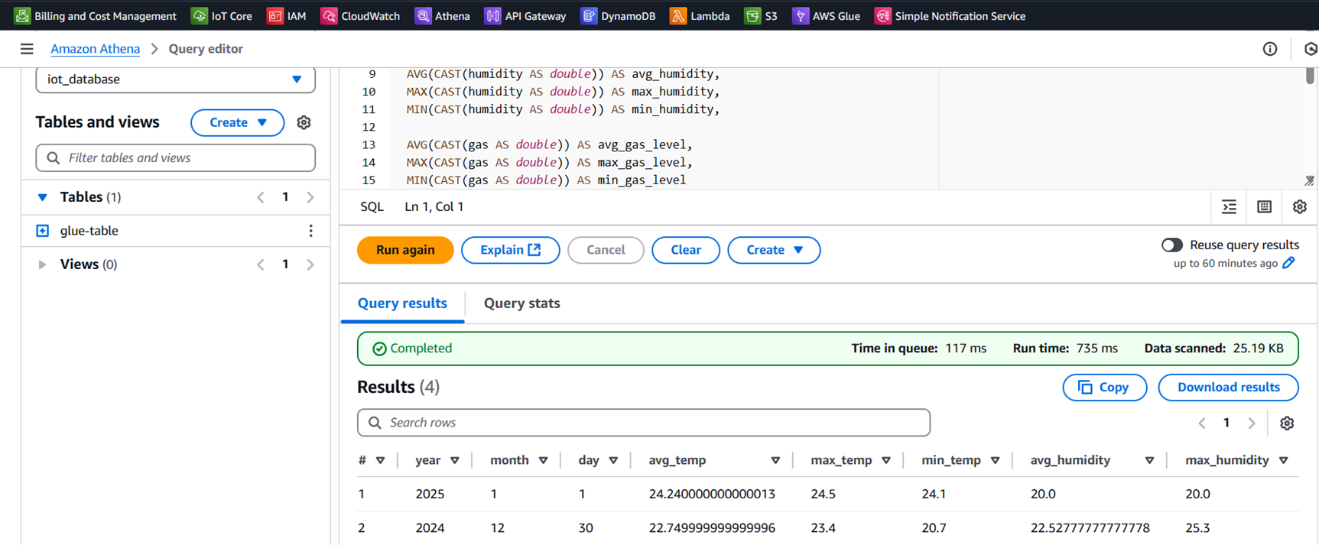

Implementation
Athena queries data to generate insights on environmental metrics for example, the query calculates : daily averages, maximums, and minimums for temperature, humidity, and gas values.
The results will store in the S3 folder (” athena-results/”).

Slide 12
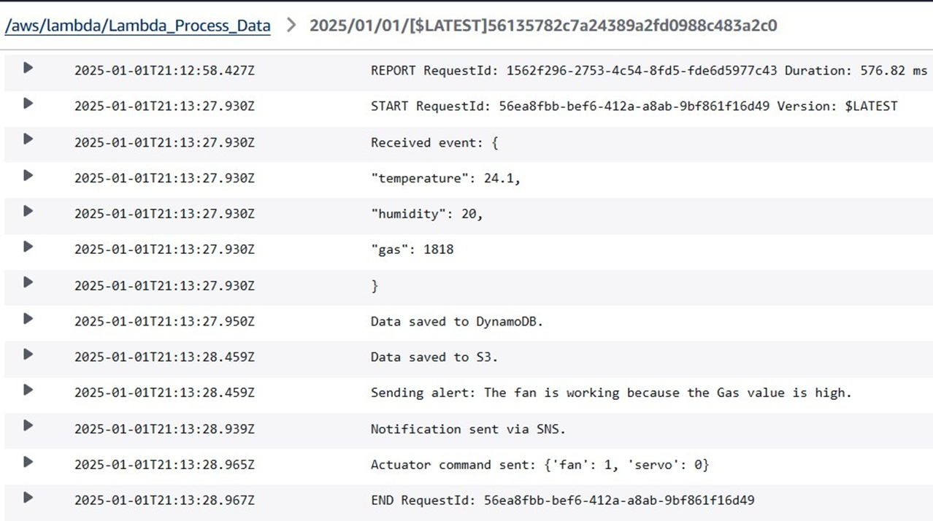
Implementation
Cloud Watch logs record Lambda function activity, including received events, saved data in DynamoDB and S3, sent SNS notifications, and actuator commands. The logs enable debugging, performance tracking, and error resolution

Slide 13
Future Developments & Conclusion
Future Development:
Integrate AI/ML for predictive analytics.
Expand sensor coverage for more parameters.
Develop a mobile application for real-time notifications.
Enhance reporting capabilities with custom dashboards.
Conclusion:
Successfully implemented an IoT-driven environmental monitoring system.
Leveraged AWS services for efficient data management and analysis.
Demonstrated scalability, cost-efficiency, and real-time functionality.

